Slide 1
ERP System
SAP Overview
ERP System
A Business software system which should be responsible to record all the activities in the Business
Example: SAP ECC, Oracle APPS, Microsoft Dynamics, Infor, Epicor, JD Edwards etc..
SAP R/3
SAP ERP
ABAP

Slide 2
SAP R/3
A Platform to run SAP Applications
SAP Overview
ERP System
Generally some applications will be executed directly on top of the Operating System.
Example: MS Office directly installed and executed
But some Application will be executed on other software's.
For Example: GMAIL will be run on Web Browser.
So to run SAP Applications, we need SAP R/3 software
SAP R/3
SAP ERP
ABAP

Slide 3
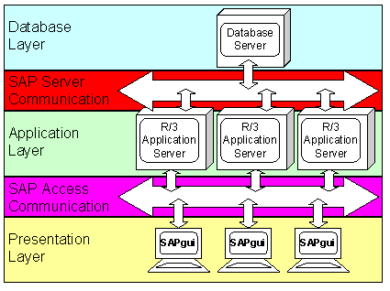
SAP R/3
A Platform to run SAP Applications
SAP Overview
SAP R/3 is composed of 3 components
Database Server
It is responsible for run Database Objects include Database Tables and Views
Application Server
It is responsible for running actual application Programs
Presentation Server
This is light weight component and installed in every user desktop to access SAP Applications. End User can access SAP Applications using SAP GUI
ERP System
SAP R/3
SAP ERP
ABAP

Slide 4
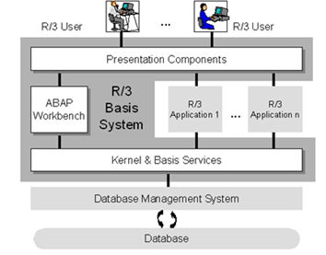
SAP ERP System: SAP ECC
What is contained in the SAP ECC system
-> Set of Tables
-> Set of Programs
Which are required for recording activities in the business such as
Procurement/Purchasing Process
Sales Activities
Delivery Activities
Billing Activities
Shipping Activities
Inventory Activities etc.
SAP Overview
ERP System
SAP R/3
SAP ERP
ABAP

Slide 5
ABAP
Advance Business Application Programming
SAP Overview
ERP System
It is a programming language. Programs developed with ABAP Programming Language.
Every Programming Language has
Design guidelines
Syntax Rules
Basic Statements
Flow of Program Execution
Data types
Operators
Modularization Techniques etc.
SAP R/3
SAP ERP
ABAP

Slide 6
ABAP
Advance Business Application Programming
SAP Overview
ERP System
Work Bench:
Set of transactions which are used to develop various objects called Work Bench or Development Work Bench
Some Transactions:
SE11 – ABAP Dictionary/Data Dictionary/DDIC
SE16 – Display Entries
SE38 – ABAP Editor
SE37 – Function Builder
SE24 – Class Builder
SE41 – Menu Painter
SE51 – Screen Painter
SE93 – Transaction
SE80 – Object Navigator
SE91 - Messages
SAP R/3
SAP ERP
ABAP

Slide 7
ABAP
Advance Business Application Programming
SAP Overview
ERP System
Root Cause Analysis
Debugging
Debugger is a tool which help the developer to analyze the program
There are two types of Debuggers
Classic Debugger/Old Debugger
New Debugger
Start Debugging
/H – Start the debugging When Executing the transaction
Setting Break points in the program before executing
Analysis
ST22 – Runtime Error Analysis
SM21 – Application system Log
SAP R/3
SAP ERP
ABAP

Slide 8
ABAP
Advance Business Application Programming
SAP Overview
Quality Assurance and Performance Measurement
After checking the functionality it is important to check the
-> Design guidelines
-> Performance of the program
Transaction for Design Guidelines:
-> To identify expensive ABAP statements/Logic
-> To identify unused variables
SCI Code Inspector
SLIN Extended Syntax Check
Transactions for Performance Measurement
ST12/SE30 – Runtime Analysis
ST03 – Workload Monitor
ST05 – SQL Trace
STAD – Workload Analysis
ERP System
SAP R/3
SAP ERP
ABAP

